Slide 1
HOSPITAL MANAGEMENT SYSTEM
2200030846 – N. YASH RAJ
2200031311 – D. MANIKANTA
2200031732 – V.GOPI KRISHNA SAI
​

Slide 2
Introduction
Welcome to the future of healthcare administration with our hospital management system
Our robust software seamlessly integrates patient care, appointments, billing, and electronic health records, streamlining operations for enhanced efficiency. With user-friendly features and optimized collaboration, our HMS ensures a patient-centric approach, revolutionizing how healthcare is managed and delivered.

Slide 3
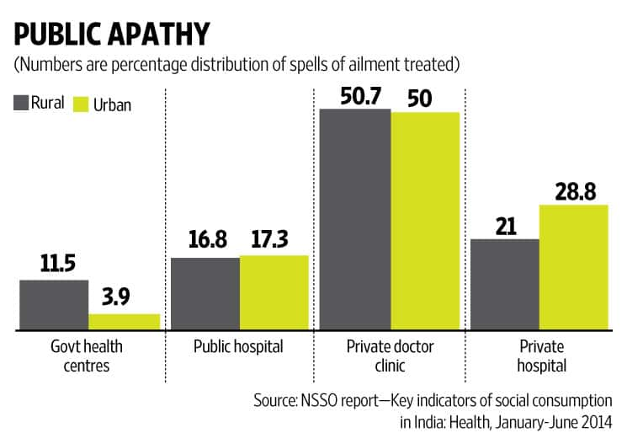
HOSPITAL MANAGEMENT SYSTEM IN AP

Slide 4
Problem statement
Current hospital management systems face challenges in achieving seamless integration and efficient data exchange, leading to operational bottlenecks and potential compromises in patient care and administrative processes."

Slide 5
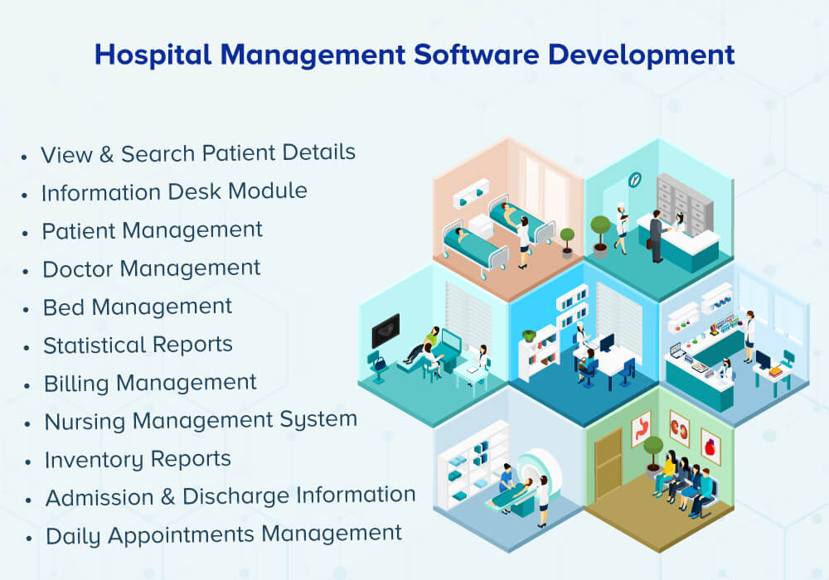

Slide 6
Solution Overview
Advanced Integration Protocols: Implementing robust protocols to ensure seamless data exchange within the hospital management system.
Interoperability Focus: Prioritizing interoperability to foster smooth communication and coordination among various healthcare processes.
Optimized Efficiency: Upgrading the system to enhance overall efficiency, thereby improving patient care and administrative workflows.

Slide 7
Key Modules
List and briefly explain major modules/componentsPatient
Appointment Scheduling
Electronic Health Records (EHR)
Billing and Payment
Pharmacy Management
Staff Management
Reporting and Analytic

Slide 8
benefits
Efficiency
Accuracy
Cost Savings
Patient Satisfaction
Time Management
Data Security
Financial Transparency
Compliance
Reporting and Analytics
Staff Productivity

Slide 9
Conclusion
In conclusion, the Hospital Management System project represents a pivotal step towards modernizing healthcare operations. With its robust features, including streamlined patient management, efficient scheduling, and accurate record-keeping, this system significantly improves overall hospital efficiency. The project's successful implementation not only enhances administrative processes but also contributes to the delivery of superior patient care.

Slide 10
THANK YOU
2200030485 – BOMMAREDDY KEERTHANAREDDY
2200031601 – YENUMULA SRAVANTHI
2200031803 – MARREDDY LALASA

